Slide 1
Filling the Land Conversion Gap with Machine Learning
Byron Allen
Data Science Student at General Assembly
22 October 2016

Slide 2
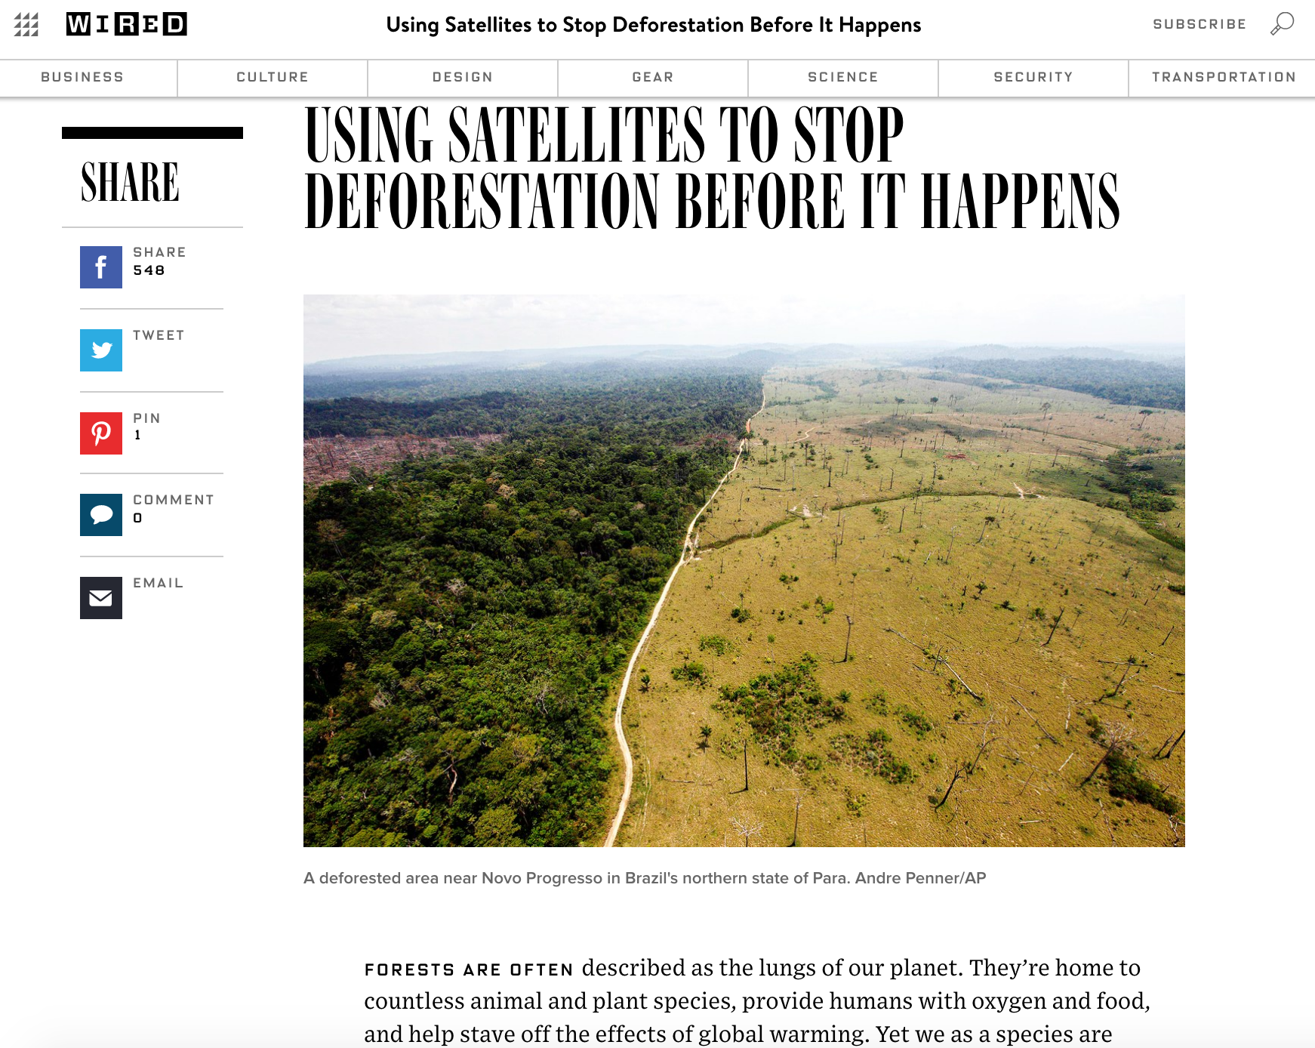
Land Conversion (LC)
https://www.wired.com/2015/04/using-smart-satellites-to-monitor-deforestation-from-space/

Slide 3
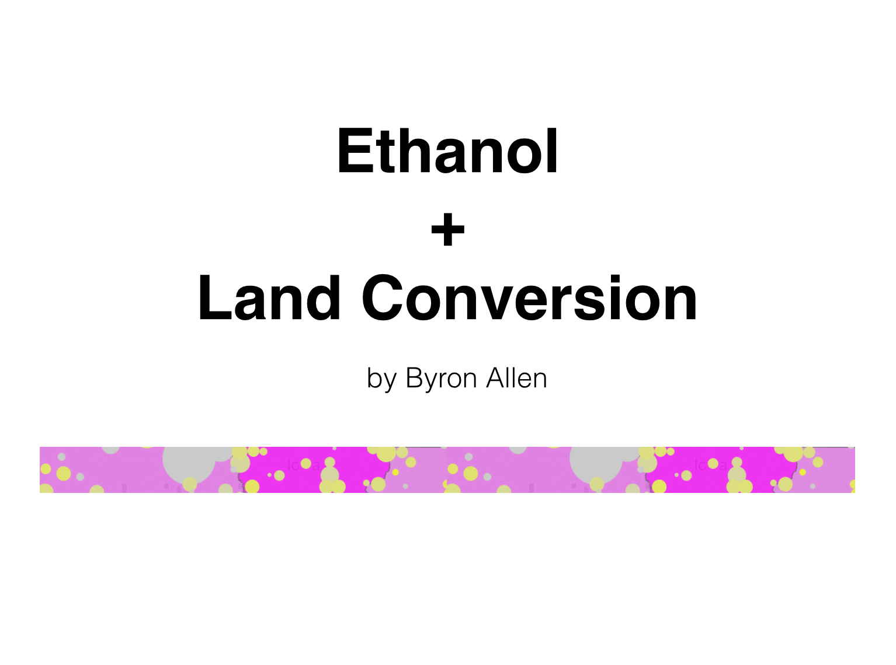
Lack of Land Conversion Data
PDF link
Video presentation link​
​Tableau Dashboard link​

Slide 4
How do we fill the gap?

Slide 5
Workflow
Satellite Images
(EVI & RAW)
Agriculture Mask &
Vegetation-Bare Earth Array
Unsupervised Method
to Classify Land Cover
Train & Apply
Supervised Method
Consolidate Labels
Apply Ag Mask

Slide 6
Assumptions & Limitations
Geospatial sits outside the scope of GA
Clouds were avoided as much as possible
Data ranges from 2013 – 2015
Need for mixed land type to train on

Slide 7
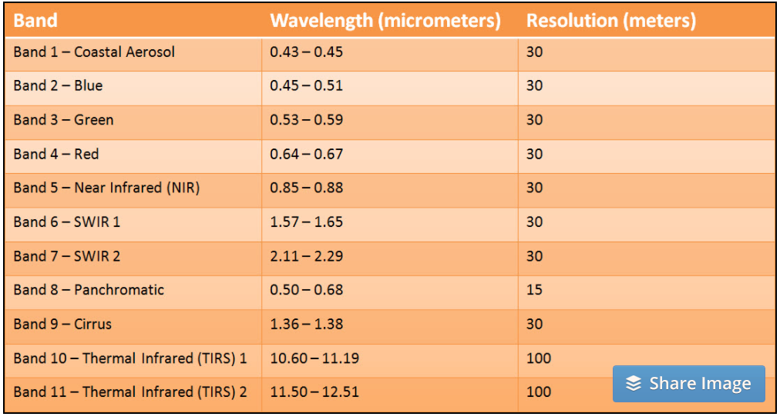
Satellite Images (Landsat 8 EVI & RAW)
http://www.harrisgeospatial.com/Home/NewsUpdates/TabId/170/ArtMID/735/ArticleID/14305/The-Many-Band-Combinations-of-Landsat-8.aspx

Slide 8
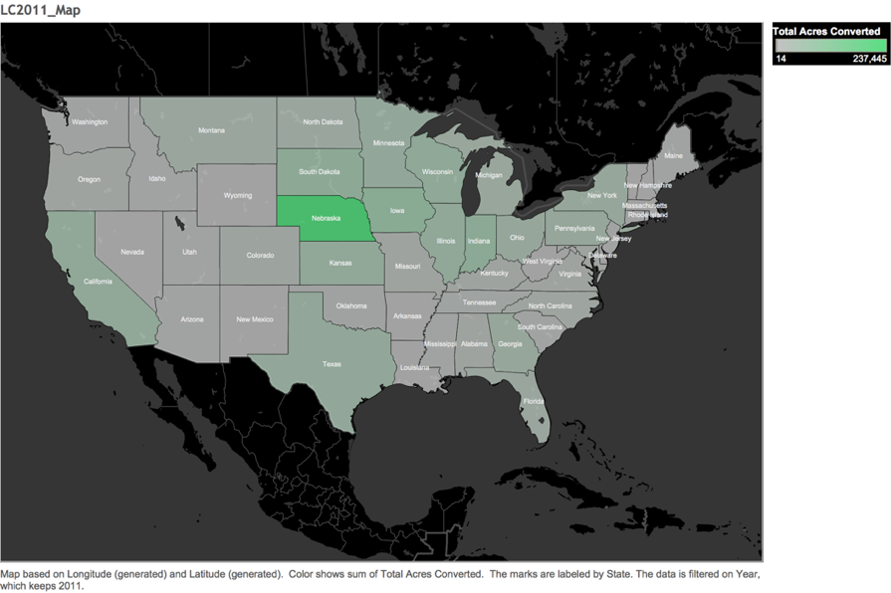
Nebraska had the Greatest LC in 2011

Slide 9
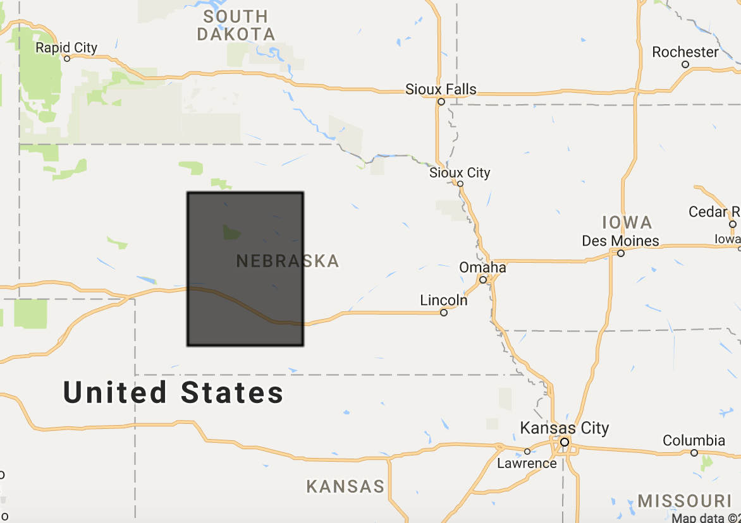
Shape of Data
Middle of Nebraska, U.S.
GTiff file downloaded from Google Earth Engine
Mix of agricultural and non-agricultural land cover
Resolution: 30m/pixel
Height: 7439
Width: 7422
Pixel Count: 55,212,258
Over 49,000km² of Nebraska’s total area 200,360km²

Slide 10
Bimodal Distribution to Create Ag Mask

Slide 11
Create Optimal Training Area
(Vegetation Array = (band_6 + band_5 + band_2) / 3)
-
(Bare Earth Array = (band_6 + band_3 + band_2) / 3)

Slide 12
KMeans (k=30) Centroid-based Labels
*Agglomerative Clustering
*Affinity Propagation
Unsupervised algorithm to define underlying features

Slide 13
Apply Ag Mask and Consolidate Labels

Slide 14
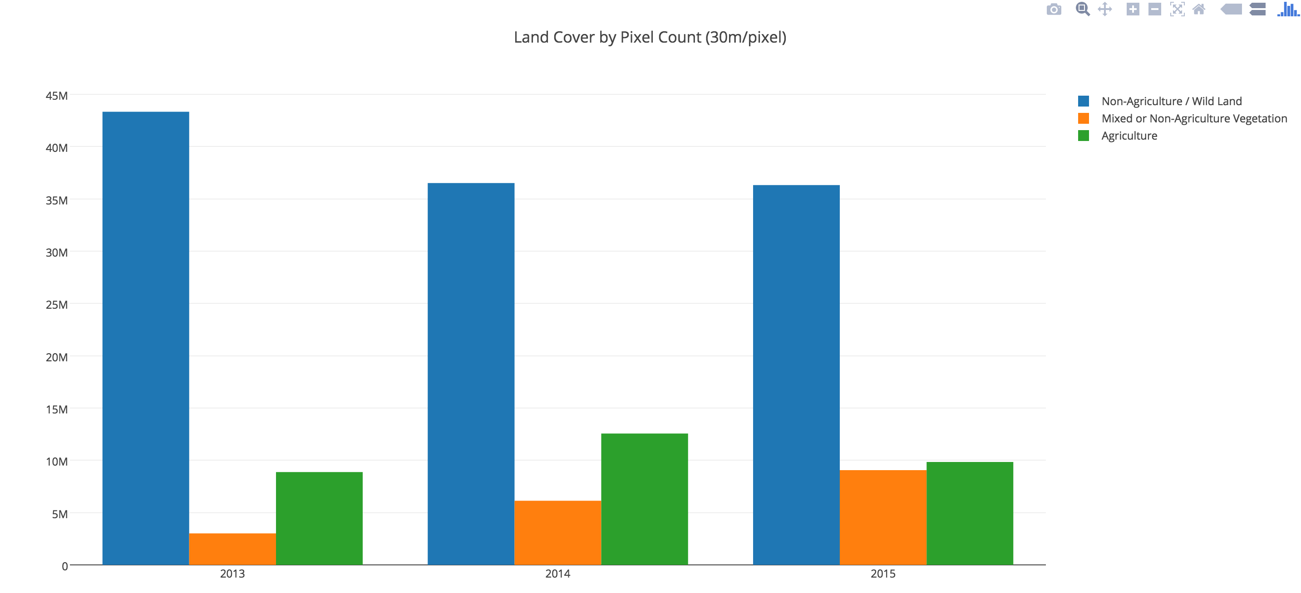
Indicator of Land Conversion

Slide 15
Model Selection
Model Selection
Testing Phase
Statistical Analysis
Results
Recommendations
Possible Next Steps
APPENDIX
Libraries
Techniques
Link to past project

Slide 16
Testing
Model Selection
Testing Phase
Statistical Analysis
Results
Recommendations
Possible Next Steps
APPENDIX
Libraries
Techniques
Link to past project

Slide 17
Apply + Analysis
Model Selection
Testing Phase
Statistical Analysis
Results
Recommendations
Possible Next Steps
APPENDIX
Libraries
Techniques
Link to past project

Slide 18
Results
Model Selection
Testing Phase
Statistical Analysis
Results
Recommendations
Possible Next Steps
APPENDIX
Libraries
Techniques
Link to past project

Slide 19
Workflow(s)
1
2
Obtain Landsat 8 32-Day EVI (1 band)
Obtain Landsat 8 8-Day Raw (12 bands)
Create Ag Mask based on the highest EVI readings
Develop vegetation array and bare earth array from raw bands
Subtract bare earth from vegetation array to produce new vegetation array
Run KMeans (k=30) on new vegetation array
Apply centroid-based labels (not out-of-box labels)
Overlay Ag Mask
Consolidate classes as needed
Train then test unsupervised methods
Apply model to next layer of data
Obtain Landsat 8 32-Day Raw (12 bands)
Develop vegetation array and bare earth array from raw bands
Subtract bare earth from vegetation array to produce new vegetation array
Flatten array for each month of a year
Train on year 1 and test on year 2
Apply model to next layer of data
3
Obtain Landsat 8 8-Day Raw (12 bands)
Agglomerative Cluster / Affinity Propagation

Slide 20
Recommendations/Next Steps
Apply first workflow to new areas
Test second workflow
Sort out agglomerative clustering
Better ag masks

Slide 21
APPENDIX

Slide 22
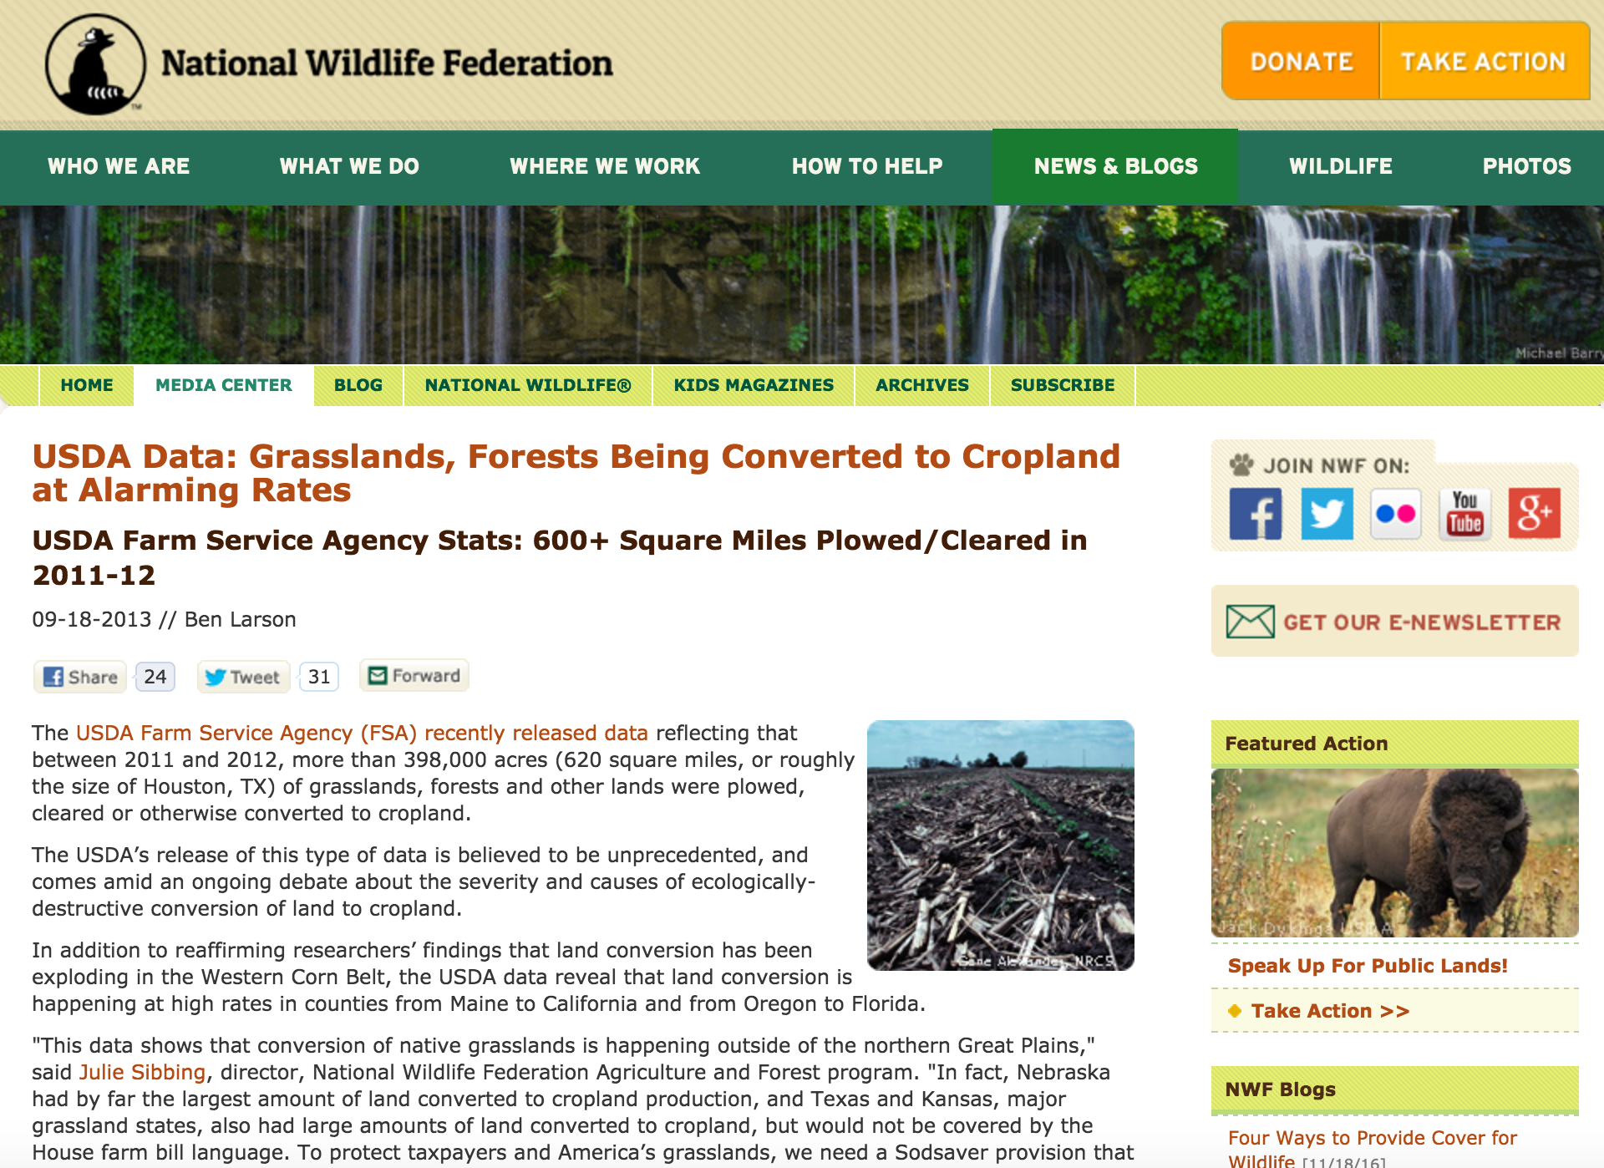
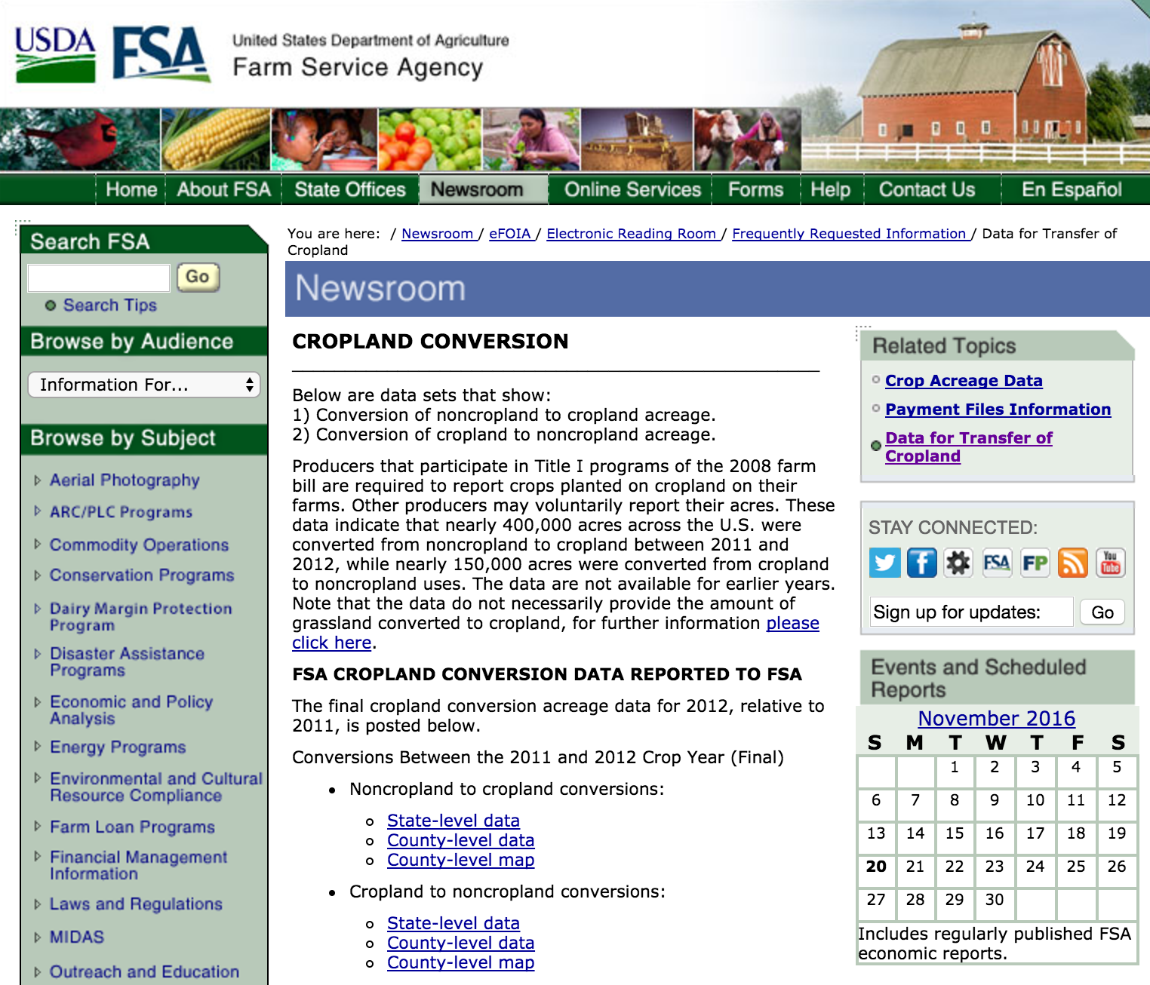
Supporting LC-related Articles
http://nationalaglawcenter.org/wp-content/uploads/assets/crs/RL33950.pdf
http://www.oecd.org/tad/sustainable-agriculture/44807867.pdf
https://www.nwf.org/News-and-Magazines/Media-Center/News-by-Topic/Wildlife/2013/9-18-13-USDA-Data-Grasslands-Forests-Being-Converted-to-Cropland-at-Alarming-Rates.aspx
https://www.fsa.usda.gov/FSA/webapp?area=newsroom&subject
=landing&topic=foi-er-fri-dtc

Slide 23
Libraries
Model Selection
Testing Phase
Statistical Analysis
Results
Recommendations
Possible Next Steps
APPENDIX
Libraries
Techniques
Link to past project

Slide 24
Techniques
Model Selection
Testing Phase
Statistical Analysis
Results
Recommendations
Possible Next Steps
APPENDIX
Libraries
Techniques
Link to past project

